Slide 1
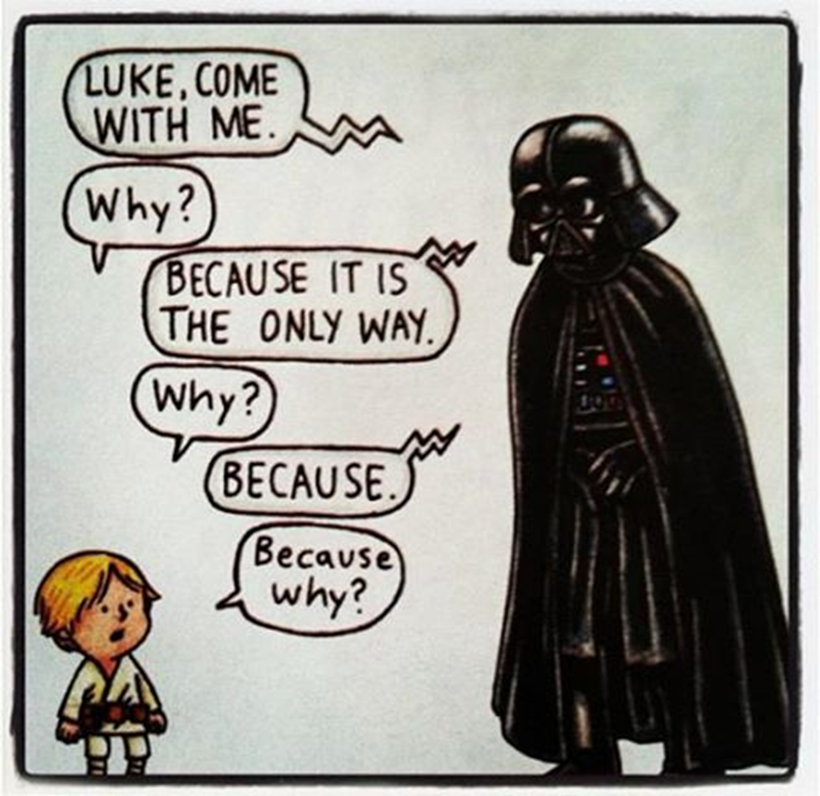
Root Cause Analysis

Slide 2
5 Whys
The 5 Whys strategy involves looking at any problem and asking: “Why?” and “What caused this problem?”
The idea is simple. By asking the question "Why" you can separate the symptoms from the causes of a problem. This is critical as symptoms often mask the causes of problems.
Using the technique effectively will define the root cause of any problem and subsequently lead you to defining effective long term corrective actions.
Often the answer to the first “why” uncovers another reason and generates another “why.” It often takes five “whys” to arrive at the root-cause of the problem.
You will probably find that you ask more or less than 5 “whys” in practice.

Slide 3
5 Whys
Simple
It is easy to use and requires no advanced mathematics or tools.
Effective
It truly helps to quickly separate symptoms from causes and identify the root cause of a problem.
Comprehensive
It aids in determining the relationships between various problem causes.
Flexible
It works well alone and when combined with other quality improvement and troubleshooting techniques.
Engaging
By its very nature, it fosters and produces teamwork and teaming within and without the organization.
Inexpensive
It is a guided, team focused exercise. There are no additional costs.

Slide 4
How to Use the 5 Whys
1. Assemble a team of people knowledgeable about the area of the problem. Include as many personnel as possible.
2. On a flip chart, presentation board, or even paper; write out a description of what you know about the problem. Try to document the Problem and describe it as completely as possible. Refine the definition with the team. Come to an agreement on the definition of the Problem at hand.
3. Have the team members ask “Why” the Problem as described could occur, and write the answer down underneath the Problem description.
4. If the answer provided from 3 (above) does not solve the Problem, you must repeat steps 3 and 4 until you do.
5. If the answer provided from 3 (above) seems likely to solve the Problem, make sure the team agrees and attempt a resolution using the answer. You may find that there are more than one root causes to the problem.

Slide 5
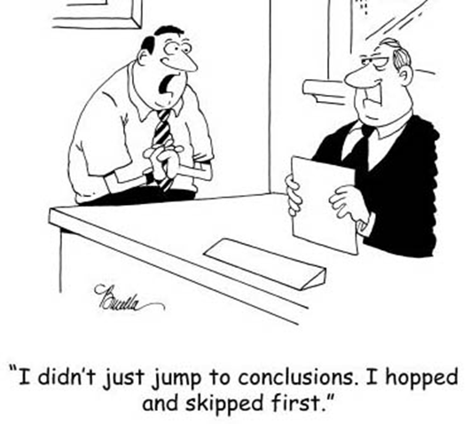
How to Use the 5 Whys
The 5 Whys can help you uncover root causes quickly.
However, making a single mistake in any question or answer can produce false or misleading results.
You may find that there is more than one root cause; corrective actions should be implemented for each of these.
To validate those potential root-causes that are under your control, you can apply the following validations to your answers or root causes.

Slide 6
Ask the following questions for every possible root-cause you identify at all levels of the 5 Whys:
Is there any proof (something you can measure or observe) to support this root-cause determination?
Is there any history or knowledge to indicate that the possible root-cause could actually produce such a problem?
Is there anything “underneath” the possible root-cause that could be more probable root cause?
Is there anything that this possible root-cause requires in order to produce the problem?
Are there any other causes that could possibly produce the same problem?

Slide 7

Improper uses of the technique
To emphasize the person or blame: turning the 5 Whys into the 5 Whos

Slide 8
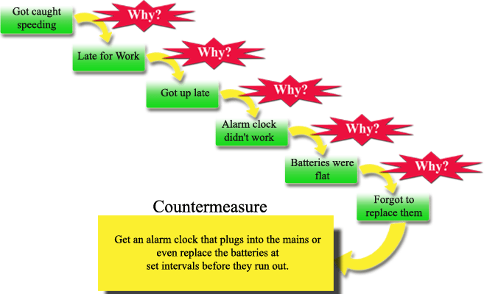

Slide 9
Problem Statement
You are on your way home from work and your car stops in the middle of the road.
1. Why did your car stop?
Because it ran out of gas.
2. Why did it run out of gas?
Because I didn’t buy any gas on my way to work.
3. Why didn’t you buy any gas this morning?
Because I didn’t have any money.
4. Why didn’t you have any money?
Because I lost it all last night in a poker game.
5. Why did you lose your money in last night’s poker game?
Because I’m not very good at “bluffing” when I don’t have a good hand.

Slide 10



Slide 11

Improvement Using PDSA
PDSA is a process improvement approach to evaluate change.
Promotes small scale rapid cycle change over short periods of time.

Slide 12
PDSA
Plan
Plan
Act
Plan
Study
Do
Act upon results
Define the problem
Gather supporting data and information
Study the results
Test your idea on
small scale
Determine the root causes

Slide 13
Event Title: | Event Sponsor: | Process Owner: | Team Members:
Value Stream: | Event Dates: | Facilitator:
P | What is the problem we are trying to solve?
Why are we doing this? What is the burning platform? What is the chief complaint? Scope – start & end points
P | What are the gaps?
What holds us back from the being at our target/goals? What are the root causes?
D | What is the plan?
What |  | Who | When | Status
1.
2.
3.
4.
P | What is our current reality?
Describe attributes of the current state: Quantitative (Money/Errors/Amounts/Time) Qualitative Use value stream or process mapping or other graphs and pictures to explain the current situation
S/A | Results at 30/60/90 days
What |  | 30 day | 60 day | 90 day
1.
2.
3.
4.
D | What are we going to do to fix the root causes?
Experiment |  | Expected Result | Actual Result
P | Where do we want to be?
Describe attributes of the future state: Quantitative Money/Errors/Amounts/Time Are metrics defined and achievable? Qualitative Use pictures and maps to visually depict your goals and targets.
Lessons Learned
What went well? What can be shared? | What can be improved?
Notes:
Problems: Clearly define the problem “a problem well defined is a problem half solved”
Current State: Did data alert you to the problem? If not, Does the data support your problem?
Target or Future: Shoot for double digit improvement try to “double the good or cut the bad in half”
Gaps: Ask why…attempt to get to root cause
Countermeasures: not called solutions for a reason….we need to trial or experiment with them first. Did it work? Does it need altered and re tested?
Implementation Plan: Now what? Assign ownership.
Study: The follow up (where we often fall short) Use the metrics to see if our plan is successful over time, if so continue to measure to assure your improvement is sustainable. If not, go back through the PDSA-maybe we didn’t get to root cause or maybe there’s another issue- put something in place and test it again.

Slide 14
Improvement Using PDSA - PLAN
Plan
What is the problem we are trying to solve?
How is it defined and what is the scope?
What information do we have?
What is the current reality?
How do you know it’s a problem? What is the root cause?
What is the outcome you are seeking?

Slide 15
Improvement Using PDSA - DO
Do
What are you going to try?
What data will you collect?
What are the results showing you?
Try on a small scale.

Slide 16
Improvement Using PDSA - STUDY
Did your plan result in improvements?
Study
Do
By how much/little?
Do you see something you didn’t expect?
If you didn’t meet your goal, go back to PLAN!
If your plan worked…ACT!

Slide 17
Improvement Using PDSA - ACT
Act
Implement on a broader scale. Then STUDY.
Were the improvements maintained? If not, go to PLAN.
What is the implementation plan? Communication plan?
What is the follow up to sustain your improvement?
What are lessons learned?
Did you celebrate your improvement?!!

